Slide 1


Global DQ PoT Experian / Anomalo
ACBSD-3141
Architect: H. Lieuw
Requestors: Kenny Boyle
15-Oct-2024

Slide 2
ARB Review History
Stage | Date | Presenter | Content | Remarks
ARB Approval | Oct 15th, 2023 | H.Lieuw | Initial review and base architecture aproval
Solution Baseline and Target Architecture |  | H.Lieuw | High Level Design Review

Slide 3
Snyk Open Source
Below table shows inflight work related to the Snyk service,
Design Repository
Motivation & foundation | Baseline & Target | Realization | Summary
ACBSD-3141 |  |  | GTS service adoption and development
 |  |  | GTS HLD Approval process

Slide 4
Data quality management
Overview
Improving data quality is crucial for effective business management and market opportunity identification. Current data issues increase costs and risks due to manual work and validation. Enhancing data quality, reducing fragmentation, and eliminating manual data handling can lower costs and provide better, more reliable insights. Data quality metrics will support business units in reaching consumers and maintaining trust, while protecting against corporate liability in handling sensitive data
Business Case & Promise of Value
The business case for the Data Quality management is;
Effective Business Management / Better Insight: Enhanced data quality allows for more reliable insight and better decision-making and management.
Market Opportunity Identification: High-quality data helps in spotting new market opportunities.
Cost Reduction: Improving data quality and reducing manual work lowers operational costs.
Risk Mitigation: Reliable data minimizes risks associated with manual validation and errors.
Corporate Liability Protection: Proper data handling shields the company from legal risks related to sensitive data.

Slide 5
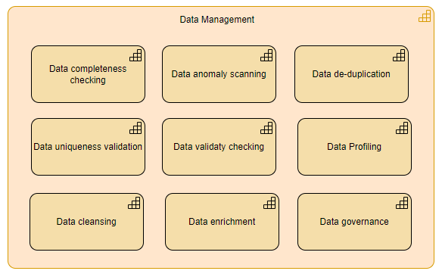
Example Capabilities

Slide 6
Baseline Architecture
Architecture view
To simplify data access, handling and permissions, the vendor applications will be set up on local EC2 instances within CT AWS account, configured as per vendor specifications. The applications are web-based applications supporting user authentication with SSO and can be installed on linux based machines. The are application connectors available to connect to several data sources.
Client access happens through the client web browser. Testing to be performed with non-production data; data to remain within company domain.

Slide 7
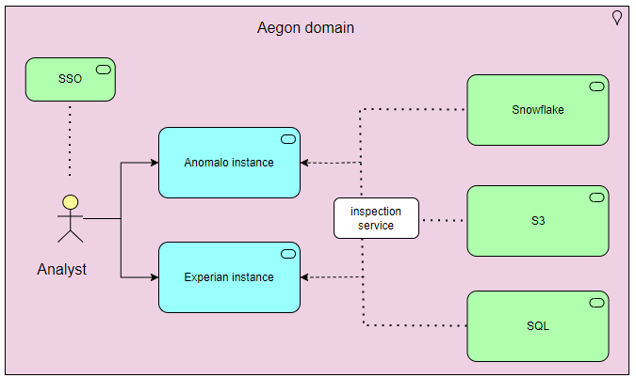
Target Architecture
Architecture view
Aegon hosted components
Application instances – offering DQ services with:
User interface – web interface for Aegon users when accessing the service
Connectors: accessing data sources
The following service will be used to manage
Default pattern authentication SSO user access
Inspection and segmentation service: inspection of (VPC) traffic
Logging to be handled with standard Observability service.

Slide 8
Success Criteria
Validation of functional criteria
Ability to identify, monitor, report and manage data quality for key systems of record
Consistent approach to managing data quality
Ability to analyze data from source without importing
Ability to segregate user groups access to own data and function
Ability to implement low code data rules
Ability to connect to several types of data sources

Slide 9
Target Architecture
Proposed implementation
The implementation project will follow the following high-level activities.
Arrange trial licenses
Configure AWS Network Configuration
GTS CT to setup applications.
Setup agreed Active Directory groups – (GTS and Business Units)
Configuration of SSO by GTS Web Security and Inspection Team.

Slide 10
Global DQ
Reviews
Reviewer | Date
GTS CT | Ongoing
GTS Pre-ARB | ^{15th} Oct
GTS ARB | ^{17th} Oct (planned)

Slide 11

Questions

Slide 12
End of presentation

Slide 13
Cost considerations
Licenses model differ per vendor. For Anomalo the licenses costs are table based; the more tables and data are required the more costs are involved. For Experian there is an all-inclusive set price.

